Slide 1
Chapter 2
PRINCIPLES OF MARKETING
Philip Kotler and Gary Armstrong
Company and Marketing Strategy

Slide 2
Strategy is the matching of the activities of an organisation to the environment in which it operates and to its own resource capabilities
Johnson and scholes (1988)

Slide 3
Vision Statement
A vision statement should answer the basic question, “What do we want to become?”
The vision statement should be short, preferably one sentence, and as many managers as possible should have input into developing the statement.
Examples
“To create a better every-day life for the many people.”
“Bring inspiration and innovation to every athlete”
“To help people and businesses throughout the world realize their full potential”
“To provide access to worlds information in one click”
“Becoming the best global entertainment distribution service”
“To give everyone a voice and show them the world”

Slide 4
Strategic Planning Process
Strategic Planning involves developing an overall company strategy for long-run survival and growth.
This process involves:
Defining a Mission: Statement of an organization’s purpose; should be market oriented.
Setting Company Objectives: Supporting goals and objectives to guide the entire company.
Designing a Business Portfolio: Collection of businesses and products that make up the company.
Planning Functional Strategies: Detailed planning for each department designed to accomplish strategic objectives.

Slide 5
Defining the business purpose or mission
Requires asking fundamental questions:
What business are we in?
What businesses do we want to be in?
Who is our major competitor?
What markets are we in?

Slide 6
Mission formulation and statement
The strategic intent or vision of where organization want to be in foreseeable future
The values of the organization should be spelled out to guide operations
Articulate distinctive competencies
Market definition, in terms of customer targets
Finally, it should spell out where organization intends to be positioned in marketplace
”to empower every person and organization on the planet to achieve more”

Slide 7
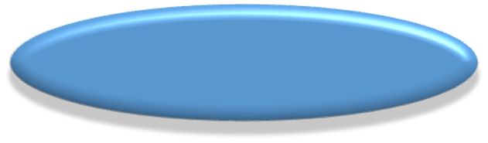
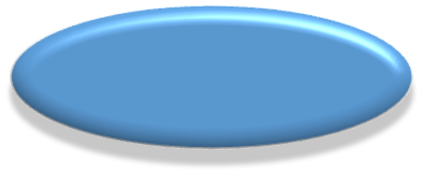



Components of mission
Strategic intent
Vision of what you want to be
Market definition
Customer targets
Mission
Objectives and strategy
Company values
Guiding principles
Competitive positioning
Differential advantage
Distinctive competencies
Core skills

Slide 8
Designing the Business Portfolio
The collection of businesses and products/services that make up the company.
Meta: Facebook, Instagram and WhatsApp
Apple: iPhone, iPad, iPod, MAC and iWatch
The best portfolio is the one that best fits the company’s strengths and weaknesses to the opportunities in the environment.
Analyzing the current business portfolio:
analyze its current business portfolio or Strategic Business Units (SBU’s)
decide which SBU’s should receive more, less, or no investment
develop growth strategies for adding new products or businesses to the portfolio

Slide 9
Strategic Business Units
A strategic business unit, popularly known as SBU, is a fully-functional unit of a business that has its own vision and direction.
Typically, a strategic business unit operates as a separate unit, but it is also an important part of the company. It reports to the headquarters about its operational status.
The purpose of identifying the company's strategic business units is to develop separate strategies and assign appropriate funding.

Slide 10
SBU has four characteristics:
A distinct mission and specific target market
Control over its resources
It has its own set of competitors.
It has a manager who is responsible for strategic planning and profit performance.

Slide 11
Analyzing Current SBU’s: Boston Consulting Group Approach
Relative Market Share
High Low
Stars
High growth & share
Profit potential
May need heavy
investment to grow
Question Marks
High growth, low share
Build into Stars/ phase out
Requires cash to hold
market share
Market Growth Rate
Low High
Cash Cows
Low growth, high share
Established, successful
SBU’s
Produces cash
Dogs
Low growth & share
Low profit potential
Notes:
Analyzing Current SBU’s: Boston Consulting Group Approach
This CTR corresponds to Figure 2-2 on p. 39 and relates to the discussion on pp. 38-39.
Designing the Business Portfolio
The business portfolio is the collection of businesses and products that make up the company. In portfolio analysis, management evaluates the businesses for their strategic fit in meeting company objectives. Strategic Business Units (SBUs) consist of separate units of the company that can be planned independently from other company businesses.
The BCG Matrix
Stars. High growth, high share businesses. Stars often require heavy investment to build/maintain share in rapidly expanding markets. You may wish to discuss the importance of market share to product profitability at this point.
Cash Cows. Low growth, high share businesses. Cows generate profits for investment in other businesses.
Question Marks. High growth, low share businesses. Strategy must decide between further investment to move question marks to star status or phasing the product out.
Dogs. Low growth, low share. Dogs are often targets for divestment, but may still be profitable and/or contribute to other organizational goals.

Slide 12
Developing Growth Strategies
Product/ Market Expansion Grid
1. Market
Penetration
3. Product
Development
Existing
Products
New
Products
Existing
Markets
2. Market
Development
4. Diversification
New
Markets
Notes:
Product/Market Expansion Grid
This CTR corresponds to Figure 2-4 on p. 41 and relates to the material on pp. 41-42.
Developing Growth Strategies
Market Penetration. A penetration strategy involves increasing sales to present target customers. The product itself remains unchanged although there may be a substantial change in how the product is promoted. You may wish to link market penetration with other company-wide strategies such as market leader if appropriate to course progress at this time.
Market Development. A market development strategy involves identifying new segments for the current products offered by the company. Market development can be successful for old products like Arm & Hammer Baking Soda (used as a refrigerator deodorant). You may wish to link market development to emerging technologies such as geodemographics for identifying new market segments.
Product Development. A product development seeks growth by modifying existing products or introducing new products to serve an existing market. Line extensions in snack foods are often useful for illustrating this strategy to students. You may ask your class how many flavors of Doritos they can name as an example.
Diversification. This strategy involves taking profits from existing products or businesses to acquire or enter new markets, usually in different industries from previous company efforts. RJR buying Nabisco is an example.

Slide 13
Product/ Market Expansion Grid
Market Penetration: increase sales to present customers with current products. How? Cut prices, increase advertising, get products into more stores.
Market Development: develop new markets with current products. How? Identify new demographic or geographic markets.
Product Development: offering modified or new products to current customers. How? New styles, flavors, colors, or modified products.
Diversification: new products for new markets. How? Start up or buy new businesses.

Slide 14
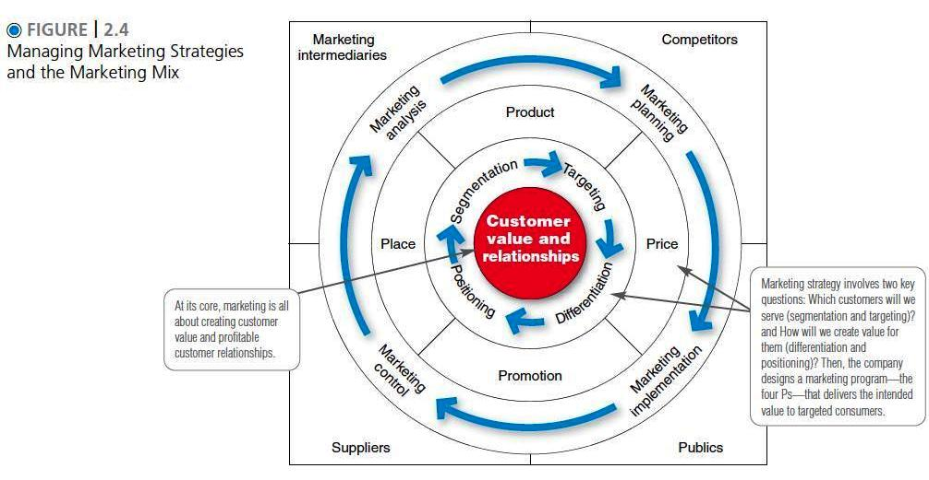
Marketing Strategy and Marketing Mix

Slide 15
Marketing Strategy and Marketing Mix
Customer driven marketing strategy
Market Segmentation: determining distinct groups of buyers (segments) with different needs.
Market Targeting: evaluating and selecting which target segments to enter.
Market Differentiation: Actually differentiating the market offerings to create superior customer value.
Market Positioning: products distinctive and desirable place in the minds of target segments compared to competing products.
Marketing Strategies for Differentiation/Competitive Advantage
Market-Leader
Market Challenger
Market-Follower
Market-Niche

Slide 16
Marketing Mix- The Four P’s
Product
“
Goods-and-service”
combination that a
company offers a
target market
Price
Amount of money
that consumers
have to pay to obtain
the product
Target
Customers
Intended
Positioning
Activities that
persuade target
customers to buy
the product
Promotion
Company activities
that make the
product available
Place
Notes:
The Four Ps of Marketing
This CTR corresponds to Figure 2-6 on p. 49 and the material on pp. 47-50.
The Marketing Mix
Product. In the contemporary mix, product is the term for the "goods and service" offering sold by the company. As technology makes everything from stereos to computers more accessible to the average buyer, service increasingly makes the competitive difference, especially in creating brand loyalty and generating repeat customers.
Place. Place refers as much to how the product arrives to the final outlet as where the customer actually buys it. Later in the course, when students distinguish between convenience, shopping, and specialty goods the logistics of getting the product to the "place" of purchase can be emphasized again.
Discussion Note: You may wish to discuss the role of infrastructure on placing decisions -- highway, rail, and waterway conditions and/or airfreight costs.
Price. Price too is an excellent source of discussion content. Students will undoubtedly know about list and discount prices as many will have had shopping experiences in discount malls. The manipulation of price in the channel of distribution through allowances, credit, and payment arrangements may be new to them.
Promotion. Promotion covers most of what students will stereotypically identify as "real marketing." While the role of promotion is important you may remind them the dangers of too much emphasis on a single component of the mix.

Slide 17
The four C’s
The four Ps concept takes the seller's view of the market, not the buyer's view. From the buyer's viewpoint, in this age of customer value and relationships, the four Ps might be better described as the four Cs.
Product---> Customer Solution Price---> Customer cost Place---> Convenience Promotion---> Communication

Slide 18
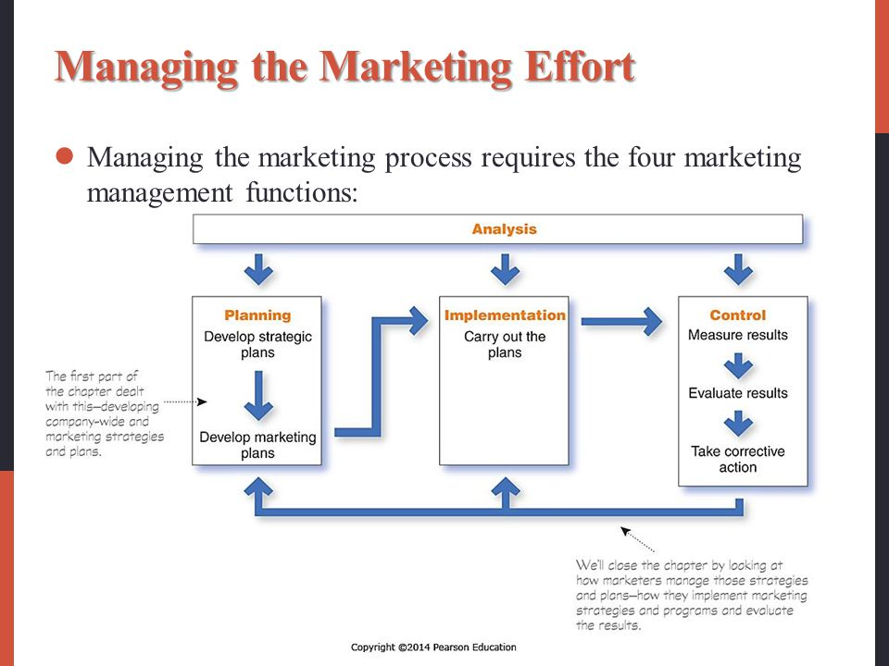
`1qqqqqqqqqqq4

Slide 19
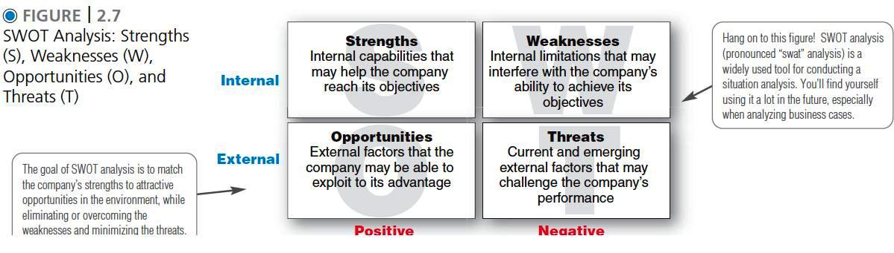
SWOT analysis A study undertaken by an organization to identify its internal strengths and weaknesses, as well as its external opportunities and threats.

Slide 20
Elements of a Marketing Plan
Executive Summary
Current Marketing Situation
Threats and Opportunities
Objectives and Issues
Marketing Strategy
Action Programs
Budgets
Controls
Notes:
Marketing Planning
This CTR relates to the material on pp. 51-52 and corresponds to the information in Table 2-2 on p. 51.
Teaching Tip: If you are using a term marketing project in the course, you may wish to handout the assignment at this time.
Marketing Plan Components
Executive Summary. This opening section provides a short summary of the main goals and recommendations for action. It should prepare the reader in anticipation of full explanations later.
Teaching Tip: Hint for students: Write this section after completing the plan.
Current Marketing Situation. This section describes the market and the company's position in it. A product review should compare all market entries. A distribution section reports sales trends and channel developments.
Threats and Opportunities. This section distills environmental scanning efforts into an appraisal of how those forces and trends affect the company. Marketing plans should both identify and rank threats and opportunities.
Objectives and Issues. This section begins the process whereby the manager translates analysis into terms for action. Based upon the preceding two steps the manager can set goals that will successfully implement company strategy.
Marketing Strategies. Just as the company has strategies for growth, the manager must define the marketing logic or "game plan" to be used in running the specific business or product. The marketing plan here must provide specific strategies for target markets, the marketing mix, expenditures, and how strategies complement and support overall marketing goals.
Action Programs. This section tells the who, what , when, and how much of the plan.
Budgets. This section is essentially a projected profit-and-loss statement. You may wish to use it as part of a diagnostic if student plans are used with a simulation.
Controls. All marketing plans must specify the means for evaluating their effectiveness. Financial goals by market by quarter are common.

Slide 21
Marketing Implementation The process that turns marketing strategies and plans into marketing actions in order to accomplish strategic marketing objectives
Marketing Strategy
Organizational
Structure
Decision
and
Reward
Human
Resources
Action
Programs
Marketing Performance
Climate and
Culture
Implementation
Notes:
Marketing Implementation
This CTR relates to the material on p. 52.
Teaching Tip: Students may have initial difficulty in developing a solid approach to implementing marketing plans. After working through the planning process itself it is often hard for students to focus again on the more concrete activities required to implement their ideas.
Marketing Implementation is the process that turns marketing strategies and plans into actions in order to accomplish strategic marketing objectives.
Action Program. This element of the implementation process coordinates the activities -- what people do -- of the plan. Decisions and deadlines for actions are specified. Lines of authority and reporting are specified. Procedures for resolving conflicts should also be provided.
Organization Structure. It should be emphasized to students that there is no one "right" organization structure. Structure is appropriate to the kind of market and competitive conditions that exist. Fast changing markets in high technology are best served by decentralized structures. Management styles from formal to informal serve company interests better if they are linked to the kind of decisions that need to be made rather that personal preferences of management. While decentralized, informal approaches are popular in fast changing markets, formal and centralized structures are often more competitive for organizations in stable markets.
Decision and Reward Systems. These must include issues of compensation but management will also benefit from attention to information networking opportunities and the role of praise and honor as effective additional roles that build a sense of company identity.
Human Resources. Recruitment and training of motivated people with the necessary skills and abilities to perform specific tasks is crucial to successful implementation of marketing plans. Combined with reward systems, you may wish to introduce extra-textual discussion of theories of management such as Herzberg’s motivators and hygiene factors here.
Climate and Culture. Company culture is a system of values and beliefs shared by people in the organization that provide collective meaning and identity. This system serves as the context for determining meaning and guides decision making.
Marketing Implementation

Slide 22
Marketing Control
Set Marketing Goals
Measure
Performance
Evaluate
Performance
Take Corrective
Action
Notes:
Marketing Control
This CTR corresponds to Figure 2-8 on p. 53 and relates to the material on pp. 53-55 .
Marketing Control
Marketing control is the process of measuring and evaluating the results of marketing strategies and plans and taking corrective action to ensure that marketing objectives are attained. Four Steps of Control Include:
Set Goals. It is important that students understand that the control process is proactive in nature. Management starts by deciding which goals it wants to reach. Goals are integrated into all marketing plans and should be reasonable and specific.
Measure Performance. In determining the success of the marketing efforts, performance in the marketplace and the company must be objectively measured. The measurements then become the basis for considering how things are working out for the company.
Evaluate Performance. Many students will bring with them a negative connotation of the evaluation process. You may want to encourage them to think that the evaluation step is a diagnostic one. Few companies use this step or the following one for strictly punishing marketing personnel. Evaluation may identify a need for improvement for the marketers, but it also may indicated changed environmental conditions, new competitive threats, unrealistic goals, or faulty strategic assumptions. Encourage your students to articulate and discuss evaluation as a beneficial professional experience as well as an inevitable necessary part of strategic planning.
Take Corrective Action. Again, many students will see “corrective” as a necessary evil. Invite them to consider that all organizations seek feedback on performance in order to make changes in their competitive behavior. Coaches use half-time and time outs to take corrective action. Marketing managers use the control process to “tinker” with the plans in order to help all members of the marketing team perform well.

Slide 23
Class Activity 2
Identify and select any firm/brand
Introduction of the selected firm/brand
Enlist SBUs (Strategic Business Units)
Analyze each SBU using Boston consulting group technique
Suggest a suitable growth strategy

